Slide 1
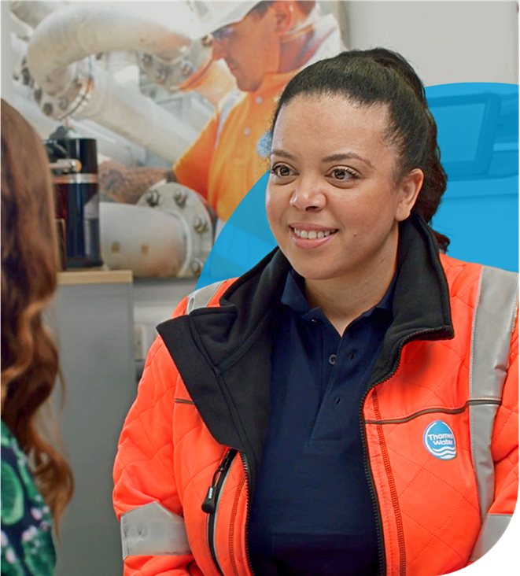

It only takes a moment
This session is designed to get us thinking about what we can each do to make working at Thames Water, even better & even safer.
We all take safety, health & wellbeing seriously, for us and our teammates, but how can we make sure that’s true even when:
We are under pressure?
Things don’t go as planned?
Life outside of work distracts us?
Watch this short movie set in one of our work environments, that shows a day in the life of a team of colleagues at Thames Water.
Consider:
What made you think?
What would you change?
What can we Learn?

Slide 2
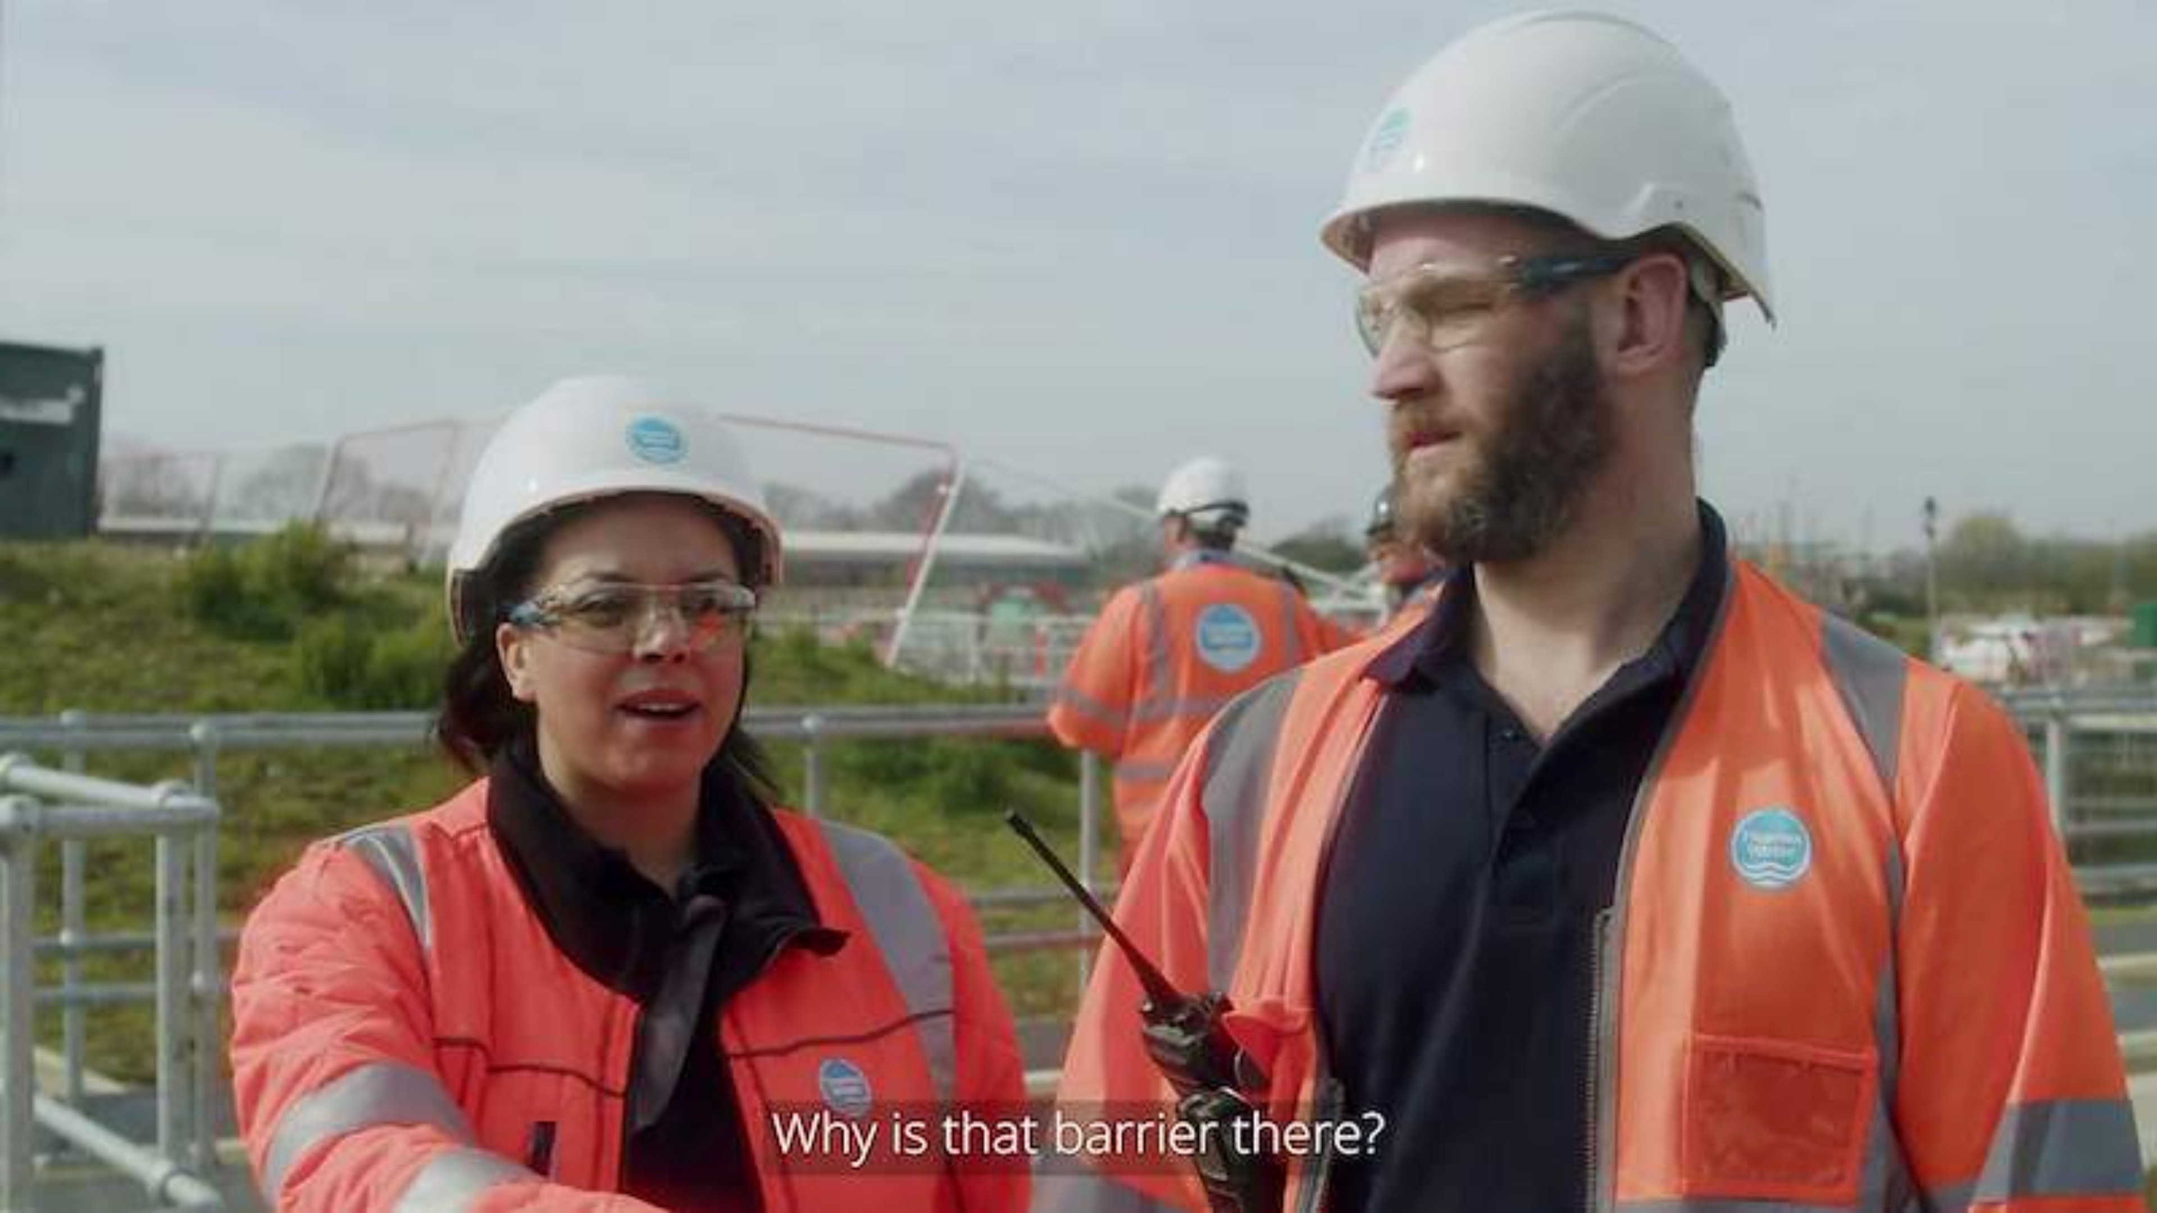
Video Link

Slide 3

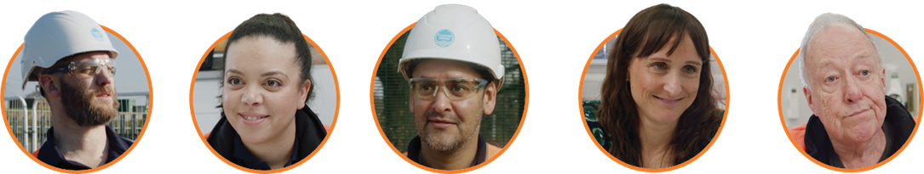
It only takes a moment
Raz
Polly
Pat
Helen
Derek
1
2
3
4
Derek has received a safety observation about a mystery vehicle on site and Helen is frustrated about the lack of information.
What examples of safety observations have you reported or received? Why are safety observations so important?
Raz wasn’t happy about having to meet Polly and Polly asks Helen if she is feeling ok and Helen opens up about a personal issue.
Would you have spoken up if you had been Polly? What more can we do
to support each others wellbeing?
Helen was distracted, key information got missed and Polly
didn’t get the best introduction to site.
What could the characters have done differently to make this briefing more affective?
Pat comes up with a time saving solution but when Polly questions it, she gets shut down.
Why is it important that everyone feels they can speak up,
no matter how experienced they are?
Find out what your colleagues had to say in Part two

Slide 4
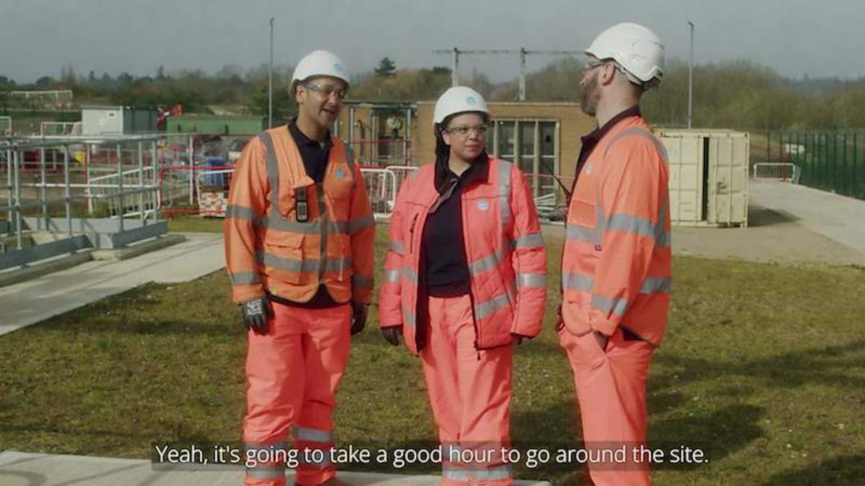
Video Link

Slide 5
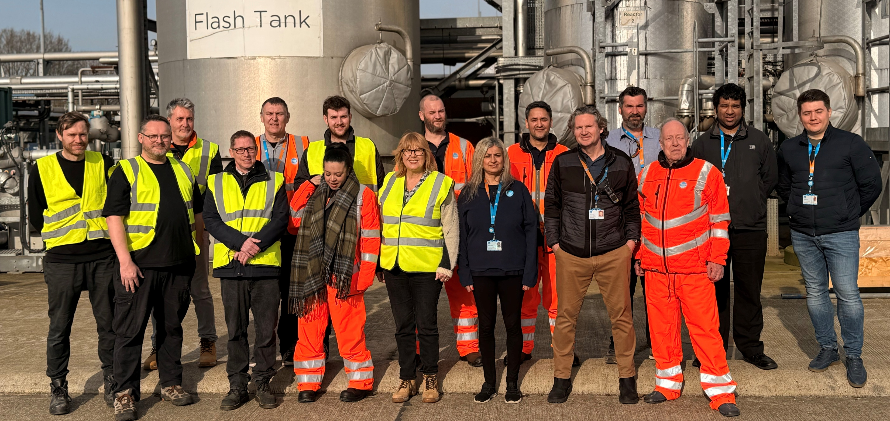
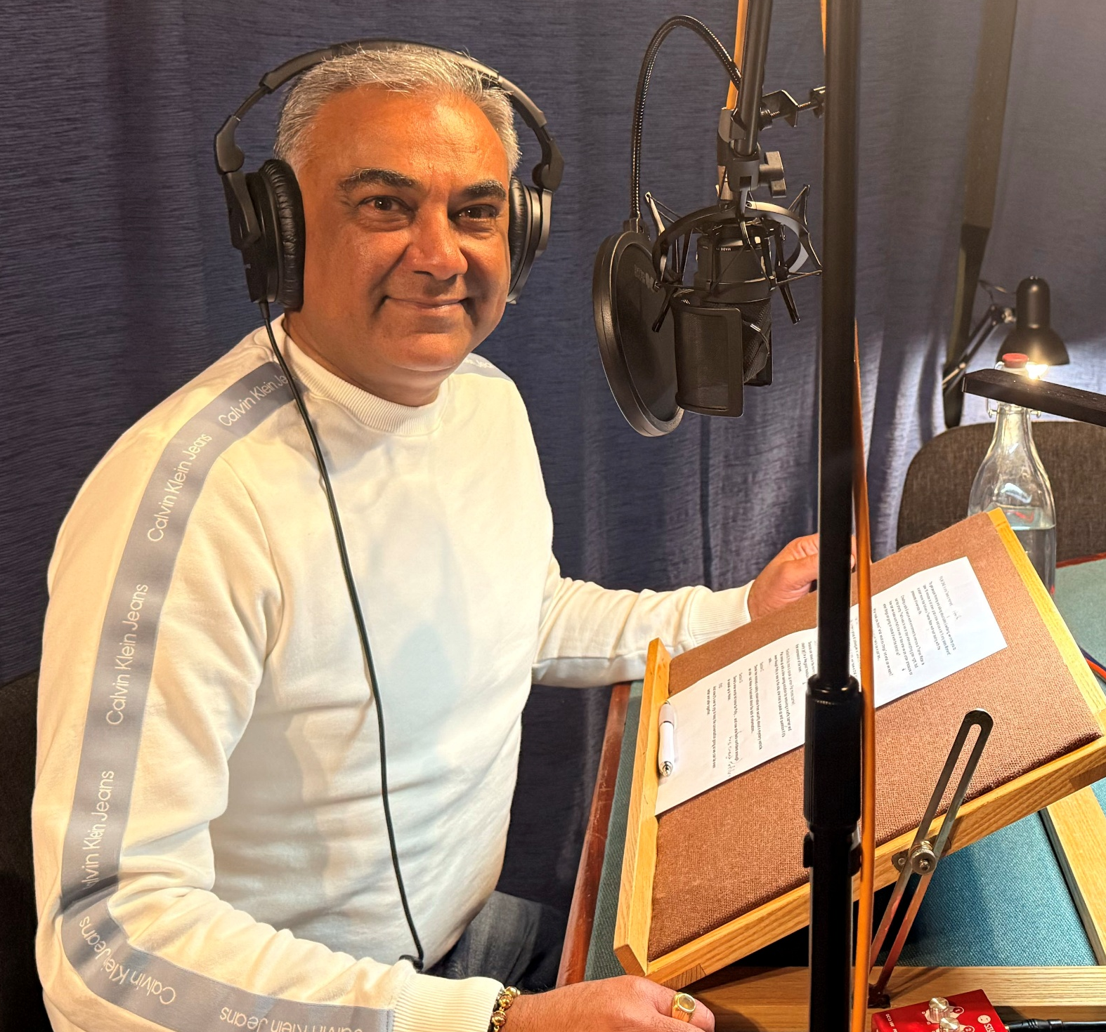
Thank you to everyone who contributed
to the making of these films

